Slide 1
Housing Data Analysis and Prediction
Yousef Ahmed
Yousef Amr
Marwan Khaled
Yahya Amin

Slide 2
Introduction
Objective: Analyze housing trends and predict median house values.
Scope: Data-driven insights into California housing dataset.
Highlight: Focus on features impacting housing affordability.

Slide 3
01.
Problem

Slide 4

Problem
Key Issue: Housing affordability and market trends.
Goal: Identify significant predictors of house prices.
Impact: Better decision-making for stakeholders.

Slide 5
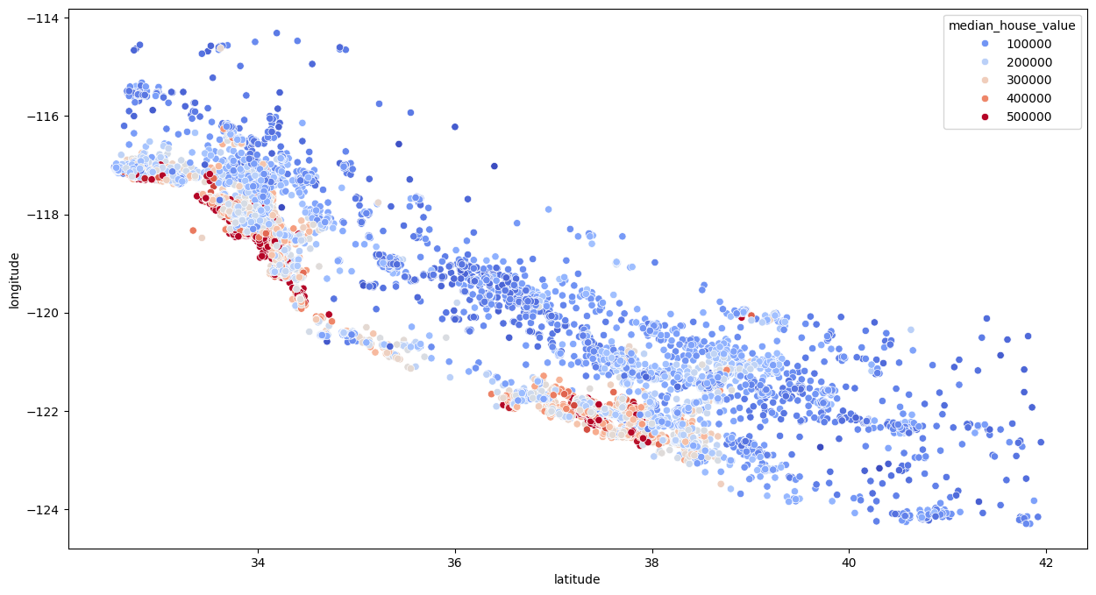
Figures
scatterplot

Slide 6
Data Preprocessing
Handling Missing Data: - Dropped rows with missing total_bedrooms values.
Feature Engineering: - Standardized numerical data. - One-hot encoding for ocean_proximity.

Slide 7
Analysis Models
Linear Regression 68%
Random Forest Regressor 82.2%
K-Nearest Neighbors (KNN) Regressor and classifier 76%
Support Vector Machine (SVM) Regressor 79.3%

Slide 8
Analysis Models
Metrics:
Mean squared error
R-squared
Outcome:
Predict median_house_value

Slide 9
thanks

